Slide 1
Building a REST API

Slide 2
Understanding REST APIs
DRF
Understanding serializers
Simplifying the code using ViewSets
Implementing authentication

Slide 3
DRF
DRF is an open source Python library that can be used to develop REST APIs for a Django project. DRF has idx_9b7cb5c1 most of the necessary functionality built in to help develop APIs for any Django project.
pip install djangorestframework
INSTALLED_APPS = ['rest_framework’,]

Slide 4
Creating a simple REST API
1. Create api_views.py in the bookr/reviews folder.
2. Add the following code in api_views.py:
from rest_framework.decorators
import api_view from rest_framework.response
import Response from .models import Book
@api_view(['GET’])
def first_api_view(request):
num_books = Book.objects.count()
return Response({ "num_books" : num_books})

Slide 5
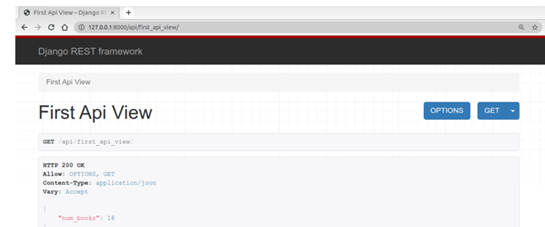
3. Open bookr/reviews/urls.py and import the api_views module.
from . import views, api_views
urlpatterns = [ path( 'api/first_api_view/' , api_views.first_api_view);]
4. Start the Django service with the python manage.py runserver command and go to http://127.0.0.1:8000/api/first_api_view/ to make your first API request.

Slide 6
serializers
if we wanted to return the full details about an actual book in our database with our API? DRF's serializer class helps to convert complex Python objects into formats such as JSON or XML so that they can be transmitted across the web using the HTTP protocol.

Slide 7
Creating an API view to display a list of books
1. Create a file named serializers.py in the bookr/reviews folder. This is the file where we will place all the serializer code for the APIs.
2. Add the following code to serializers.py:
from rest_framework import serializers
class PublisherSerializer(serializers.Serializer):
name = serializers.CharField()
website = serializers.URLField()
email = serializers.EmailField()
class BookSerializer(serializers.Serializer):
title = serializers.CharField()
publication_date = serializers.DateField()
isbn = serializers.CharField()
publisher = PublisherSerializer()

Slide 8
3. Open bookr/reviews/api_views.py, remove any pre-existing code, and add the following code:
from rest_framework.decorators import api_view
from rest_framework.response import Response
from .models import Book
from .serializers import BookSerializer
@api_view(['GET'])
def all_books(request):
books = Book.objects.all()
book_serializer = BookSerializer(books, many=True)
return Response(book_serializer.data)

Slide 9
4. Open bookr/reviews/urls.py, remove the previous example path for first_api_view, and add the all_books path, as shown in the following code:
from django.urls import path
from . import views, api_views
urlpatterns = [path('api/all_books/’, api_views.all_books, name= 'all_books’),]
5. Once all the code is added, run the Django server with the python manage.py runserver command and navigate to http://127.0.0.1:8000/api/all_books/.

Slide 10
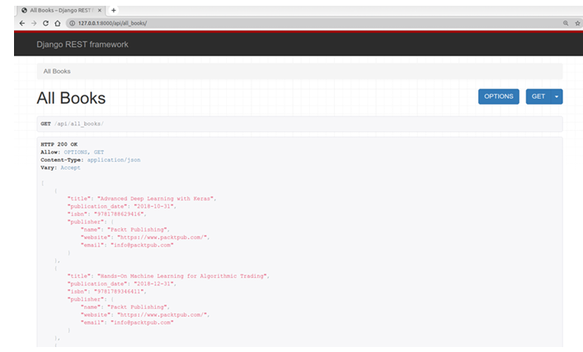

Slide 11
Class-based API views and generic views
We can also write class-based views for REST APIs.
Class-based views are the preferred way of writing views among developers, as a lot can be achieved by writing very little code.

Slide 12
Creating class-based API views and model serializers
1. Open the bookr/reviews/serializers.py file, remove any pre-existing code, and replace it with the following code:
from rest_framework import serializers
from .models import Book, Publisher
classPublisherSerializer(
serializers.ModelSerializer):
classMeta:
model = Publisher
fields = ['name', 'website', 'email']
classBookSerializer(serializers.ModelSerializer):
publisher = PublisherSerializer()
class Meta:
model = Book
fields = ['title', 'publication_date', 'isbn',
'publisher']

Slide 13
2. Next, open bookr/reviews/api_views.py, remove any pre-existing code, and add the following code:
from rest_framework import generics
from .models import Book
from .serializers import BookSerializer
class AllBooks(generics.ListAPIView):
queryset = Book.objects.all()
serializer_class = BookSerializer

Slide 14
3. Open the bookr/reviews/urls.py file and modify the /api/all_books API path to include the new class-based view as follows:
urlpatterns = [path('api/all_books/’, api_views.AllBooks.as_view(), name= 'all_books’),]
4. python manage.py runserver command, and then open the API at http://127.0.0.1:8000/api/all_books/ in the web browser.

Slide 15
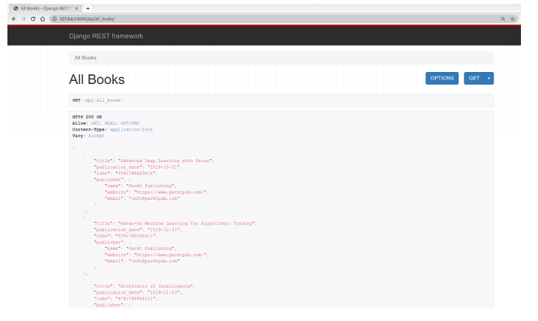

Slide 16
Creating an API endpoint for a top contributors pageShould
Imagine that your team decides to create a web page that displays the top contributors(authors, coauthors, and editors) in your database. They decide to enlist the services of an external developer to create an app in ReactJS. To integrate with the Django backend, the developer will need an endpoint that provides the following:
A list of all contributors in the database
For each contributor, a list of all books they contributed to
For each contributor, the number of books they contributed to
For each book they contributed to, their role in the book

Slide 17
To perform this task, execute the following steps:
Add a method to the Contributor class that returns the number of contributions made.
Add ContributionSerializer, which serializes the BookContribution model.
Add ContributorSerializer, which serializes the Contributor model.
Add ContributorView, which uses ContributorSerializer.
Add a pattern to urls.py to enable access to ContributorView

Slide 18
Simplifying the code using ViewSets
ViewSets and routers help us sing class-based further simplify our code. As the name indicates,
ViewSets are a set of views represented in a single class.
For example, we used the AllBooks view to return a list of all books in the application and the BookDetail view to return the details of a single book. Using ViewSets, we could combine both these classes into a single class.

Slide 19
Using ViewSets and routers
1. create the required Open the bookr/reviews/serializers.py file, remove the pre-existing code, and add the following code snippet:
from django.contrib.auth.models import User
from django.utils import timezone
from rest_framework import serializers
from rest_framework.exceptions import
NotAuthenticated, PermissionDenied
from .models import Book, Publisher, Review
from .utils import average_rating
class PublisherSerializer(serializers.ModelSerializer):

Slide 20
2. Open the bookr/reviews/api_views.py file, remove the pre-existing code, and add the following:
from rest_framework import viewsets
from rest_framework.pagination import (LimitOffsetPagination)
from .models import Book, Review
from .serializers import (BookSerializer, ReviewSerializer)
class BookViewSet(viewsets.ReadOnlyModelViewSet):
queryset = Book.objects.all()
serializer_class = BookSerializer
classReviewViewSet(viewsets.ModelViewSet):
queryset = Review.objects.order_by('-date_created')
serializer_class = ReviewSerializer
pagination_class = LimitOffsetPagination
authentication_classes = []

Slide 21
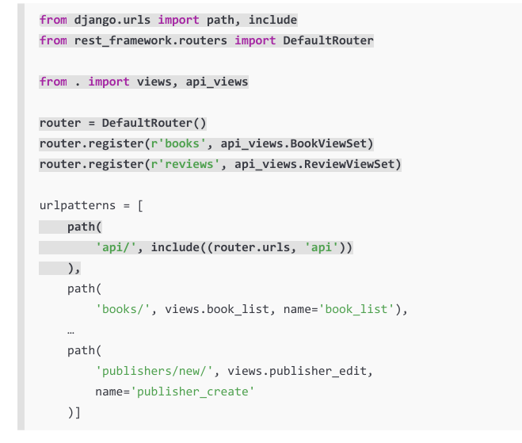
3. Next, open the bookr/reviews/urls.py file, remove the first two URL patterns starting with api/, and then add the following (highlighted) code:

Slide 22
5. Save all the files, and once the Django service restarts (or you start it manually with the python manage.py runserver command), go to the http://127.0.0.1:8000/api/ books/ URL to get a list of all the books. You should see the following view in the API explorer:
5. You can also access the details for a specific book using the http://127.0.0.1:8000/ api/books/1/ URL. In this case, it will return details for the book with a primary key of 1 (if it exists in your database):

